Slide 1
Tank 2020 - Group 4
Team member:
Yunlei Lyu
Yangfan Wang
Jia Qi Zhao

Slide 2
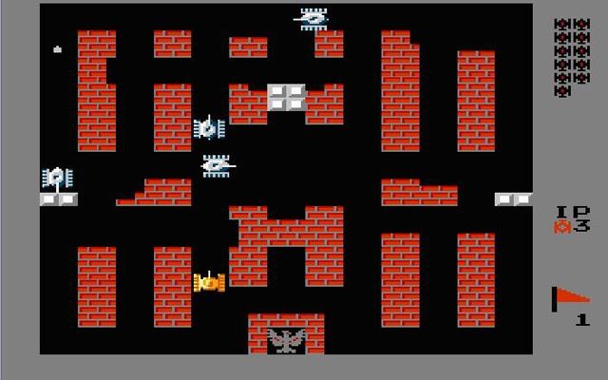

Slide 3
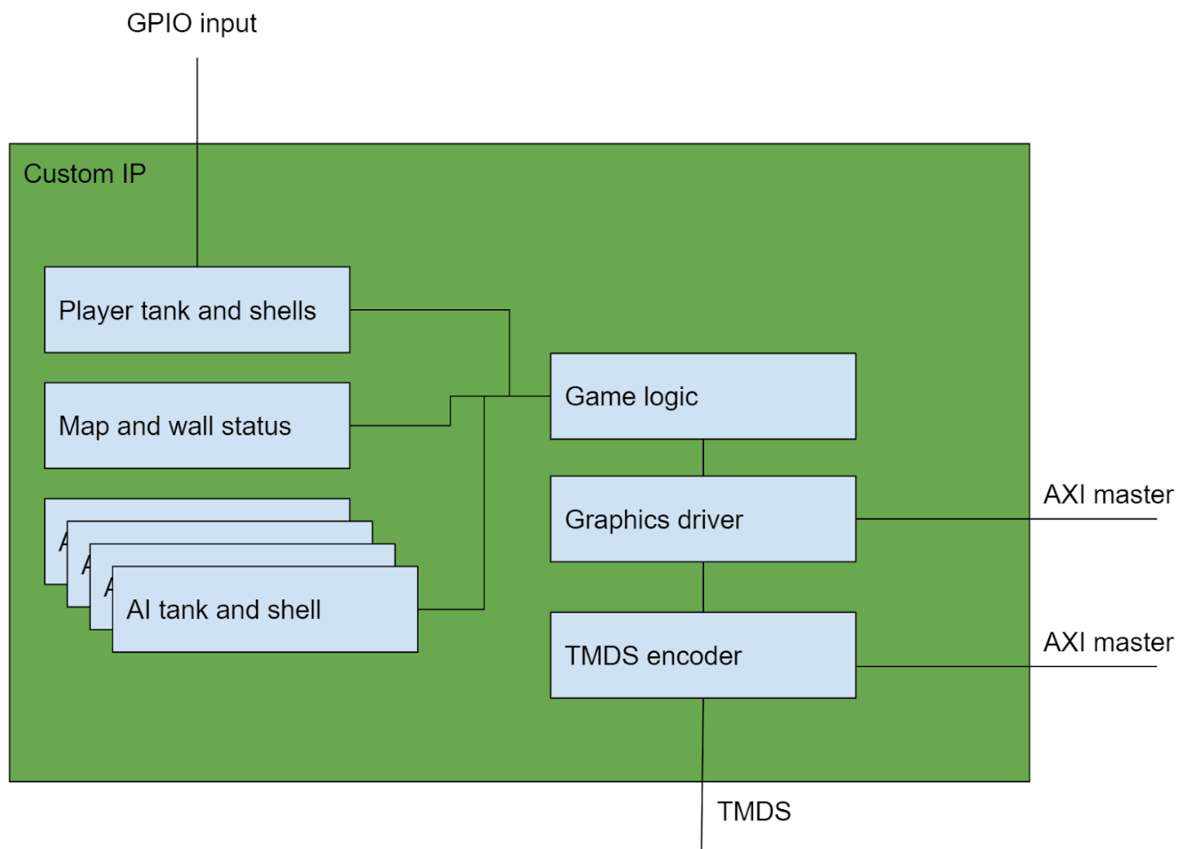
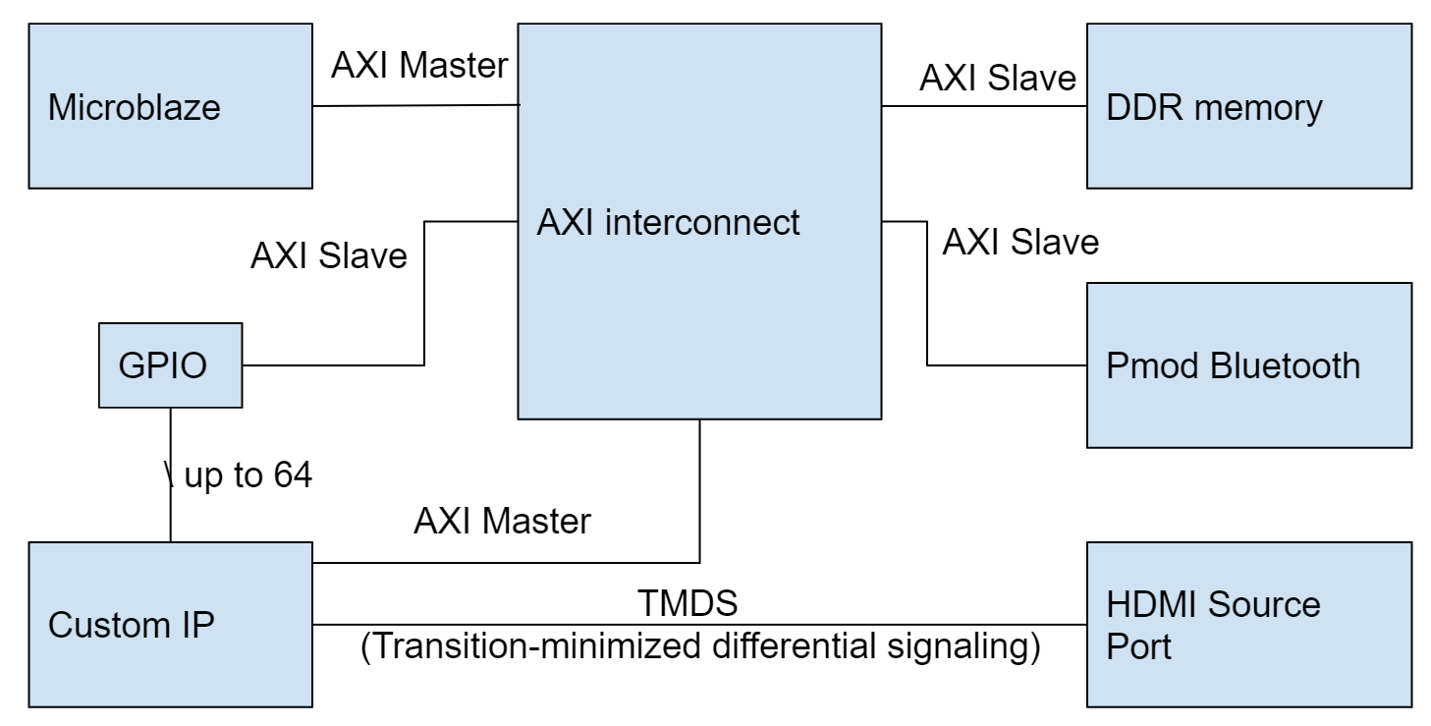
Block Diagram

Slide 4
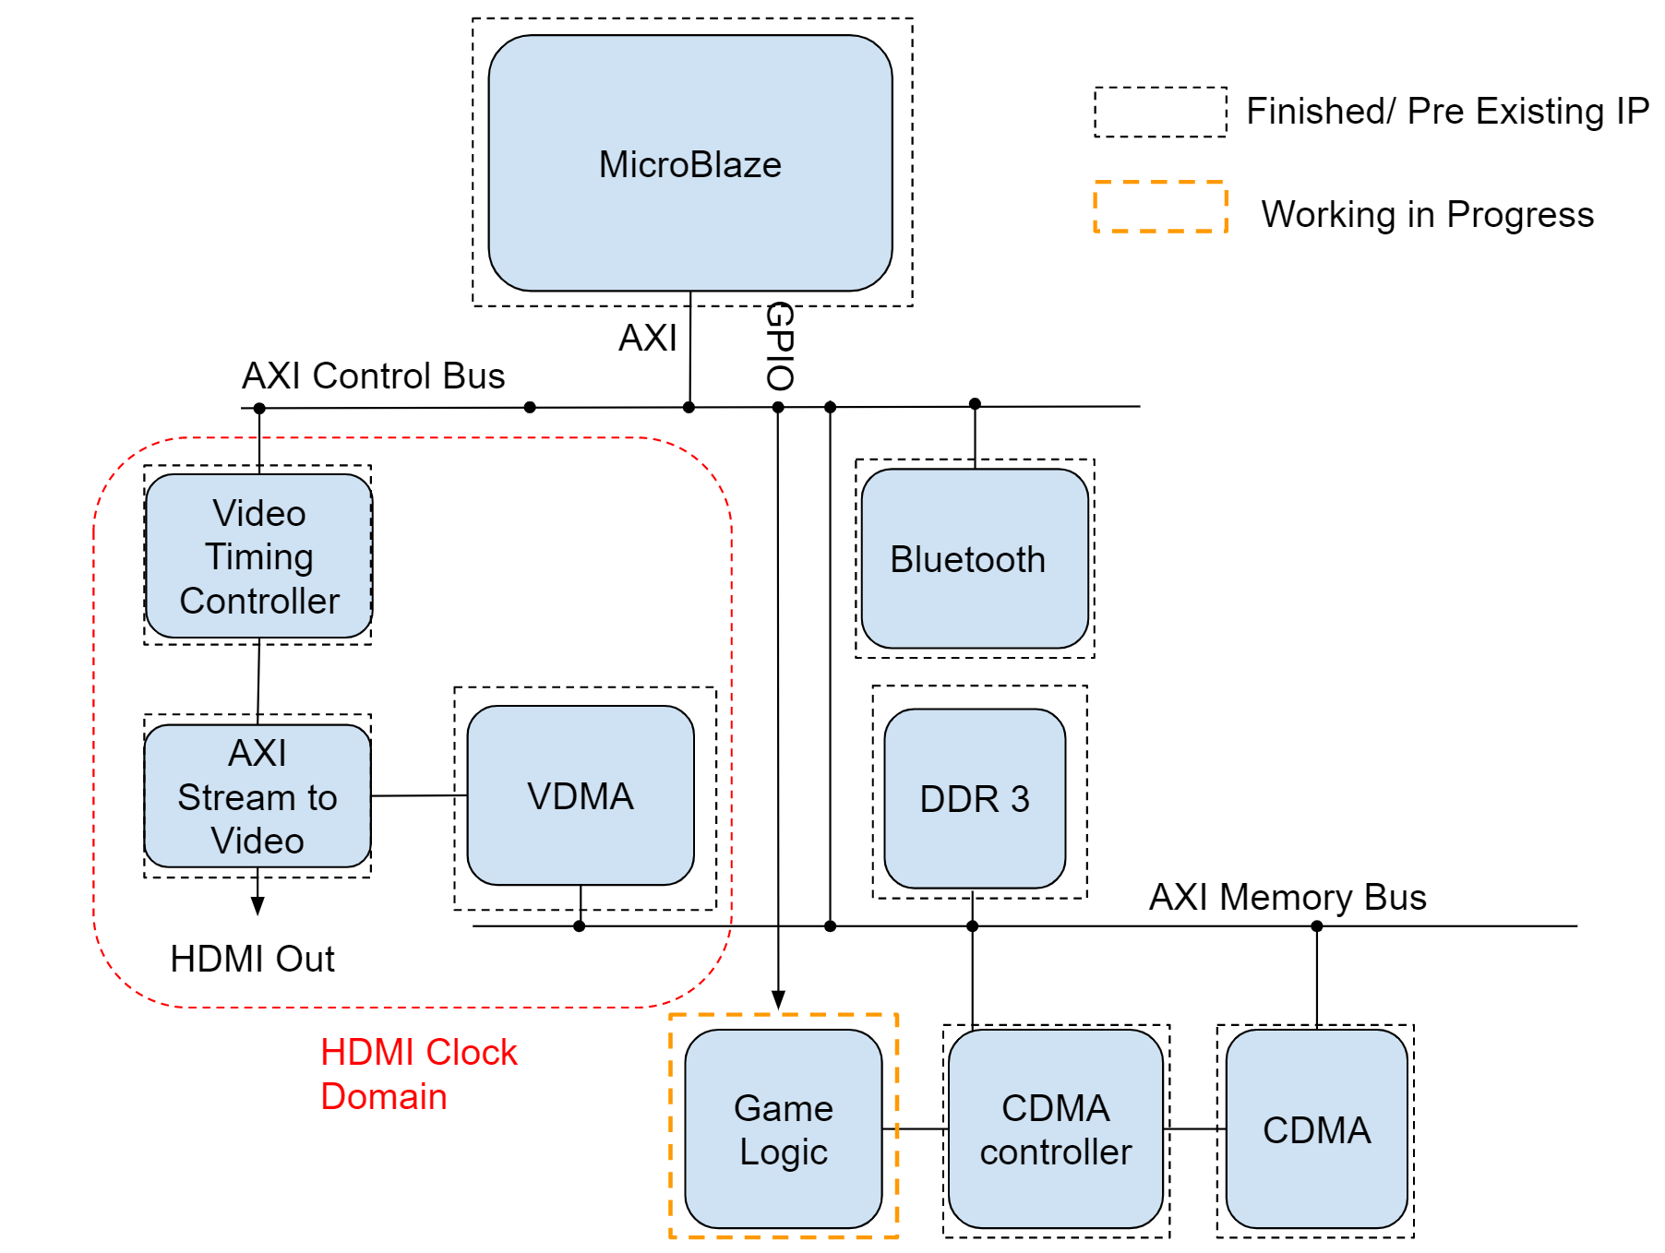
Block Diagram
Our progress
All the peripheral are connected.
Move the tank on the screen.
1920*1080 @ 60Hz

Slide 5
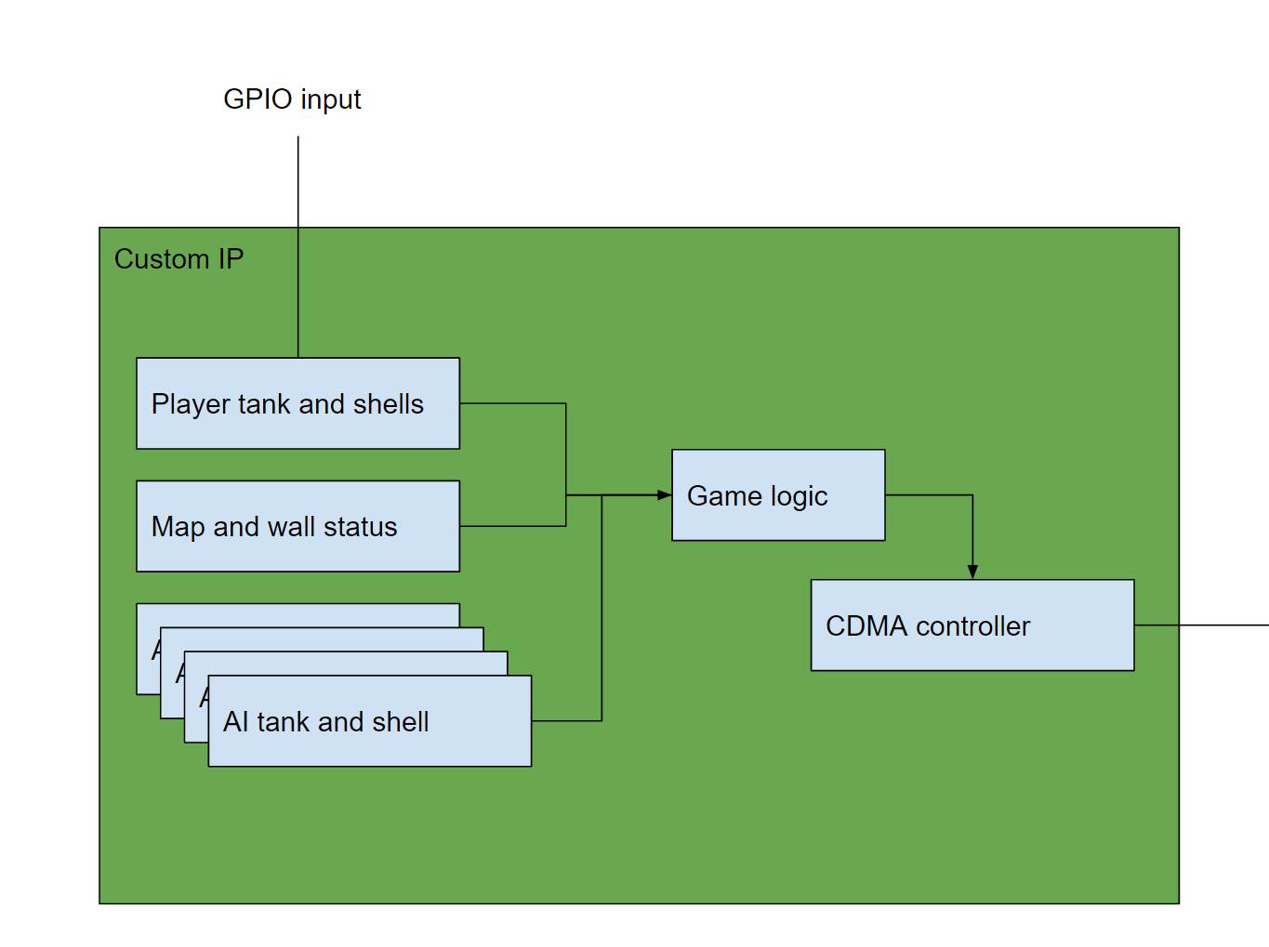
Custom IP

Slide 6
Game Logic
Process Inputs from User
Track the Position of the Tank Itself
Fire Shells and Change Position Every 0.05s
Read and Write the Map Configuration RAM
Completed
Completed
Completed
Partially Completed
Notes:
Thanks Yunlei. Beside the input and output work, we also made some progress on the game logic development. The major task we finished is on the player tank and the map status module. Up till now, our game logic can process the user input and update the position of the tank. In the meanwhile it can fire shells and create a moving animation with linear movement. Also we can readout and write to the map configuration, updating the status of the walls. This is not fully completed as we need to collaborate this with the tank modules.

Slide 7
Game Logic Next Steps
AI Tank Logic
Multiple Objects Integration
Combines the tank movement with the map configuration
Determines the collision of the shell and a tank
Determines the collision of the shell and the wall
Game-over determination
Plot multiple tanks and shells in a round-robin manner
Notes:
The next step we still have plenty to work on the game logic. The main one would be the AI tank logic as we need to implement an algorithm to control each individual tank. The other major task is combine all modules together and finish up the complete game logic. First we need to use the map configuration to decide if a tank movement if valid. If it is blocked by the wall, we can’t take the move. Also we need to use the game logic to track all the fired shells and determine if any collisions happen that we need to broadcast to the tank modules. We will also have a simple game-over determination that decides which side wins. Last, we will have a plotting manager that sends plotting requests to the CDMA module and make sure it runs at 60Hz

Slide 8
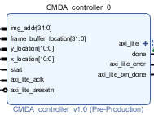



CDMA Controller
Responsible for drawing each individual game block.
Each game block is 120 x 120 pixels stored in contiguous memory space.
Move correct image to a given X,Y coordinate on screen. Discrete memory locations separated by an entire scan line.
Notes:
Thanks Leo, Now I would like to introduce you the CDMA Controller that we have implemented for drawing each individual game block. Each game block in our game is 120 by 120 pixel stored inside the DDR memory using contiguous memory space. But the Frame Buffer provided is using DDR memory that is continuous along horizontal scan line. Therefore this ip is needed for drawing each game block row by row with correct address spacing taking into consideration and leave the rest of HDMI output untouch. Therefore given an x y coordinate on screen and the address the picture stored in memory this module would print the picture into desired screen location.

Slide 9
Milestones
Milestone #1: Finish the basic layout of the entire system.
Milestone #2: Have Bluetooth working.
Milestone #3: Have the basics of HDMI working.
Milestone #4: Have HDMI working with the DDR memory.
Now
Milestone #5: Finish game logic. The tank should be able to move around and fire via Bluetooth.
Milestone #6: The AI should be working, integrating the system.
Milestone #7: Final demo.
Notes:
Now I would like to go back to the original timeline we proposed in the beginning of the course. According to this schedule the team is currently on track with most of the peripherals working which include, bluetooth, HDMI and some of the game logic.

Slide 10
Risk and Risk Mitigation
Finish the drawing sequence of all the game elements.
Implement the game logic for detecting if the tank has been hit.
Create an AI tank module for controlling the enemy tanks.
The most of the unfinished work is mainly on the game logic, which consist of:
Notes:
With the remaining work, the team has identified the following risks regarding to game logic: First, the team has to finish the drawing sequence of all the game elements such as tank shell, walls and enemy tank. Implementing the game logic for detecting if the tank has been hit, and Create an AI tank module for controlling the enemy tank.

Slide 11
Risk and Risk Mitigation
Add additional control signals in game logic block for controlling AI tanks via GPIO.
Create 2D memory in C to store the map status.
Implement game logic for detecting if a tank has been hit by a tank shell.
To mitigate those risks:
The team decides to implement an equivalent game logic in C program executed by the Microblaze.
Notes:
With the risk identified the team propose the risk mitigation plan by develop an equivalent C program that severs the same purpose as game logic. To do so the team would: 1) add additional control signals in game logic block for controlling the AI tanks via GPIO 2) Create 2D memory in C for storing the current game status, 3) implement the game logic for detecting if the tank has been hit. With those risk and risk mitigation plan the team is confident enough to finish the entire project before final demo.

Slide 12
Conclusion and Q&A
Notes:
With those risk mitigation plan and workflow. The team is confident enough to finish this project on time. Thanks you.

